Slide 1
Big Data Analytics for YouTube data

Slide 2
CONTENTS
MEET THE TEAM
PROJECT OVERVIEW
BUSINESS UNDERSTANDING
SUCCESS MEASURES FOR THE PROJECT
OUR LEARNING
CHALLENGES
NEXT STEPS

Slide 3




MEET THE TEAM DSCI 6007-01 Distributed and Scalable Data Engineering Group 7 – Spring’23 (https://github.com/sahil095/DSCI6007-01_Group7)
Sahil Sehgal Team Leader
Business Development and AWS
ssehg1@unh.newhaven.edu
Deepti Vachana
Business Understanding, Data Visualization and AWS vmaha3@unh.newhaven.edu
Shiva Kumar
Dashboard and AWS
slakk9@unh.newhaven.edu
Krishna Surendra
Data pipeline using AWS and SQL
kpale1@unh.newhaven.edu

Slide 4
PROJECT OVERVIEW
In this project we’re going to execute an end-to-end data engineering pipeline from gathering data to analyzing data for marketing campaign using YouTube as advertising channel and creating final dashboards. We will follow an architecture to make use of AWS services and create seamless pipelines.
We will answer questions like:
How a video becomes “Trending”
How to Categorize videos based on their comments and statistics
Are there any difference in Trending videos in English speaking countries?
Rank videos based on categories to target audience

Slide 5
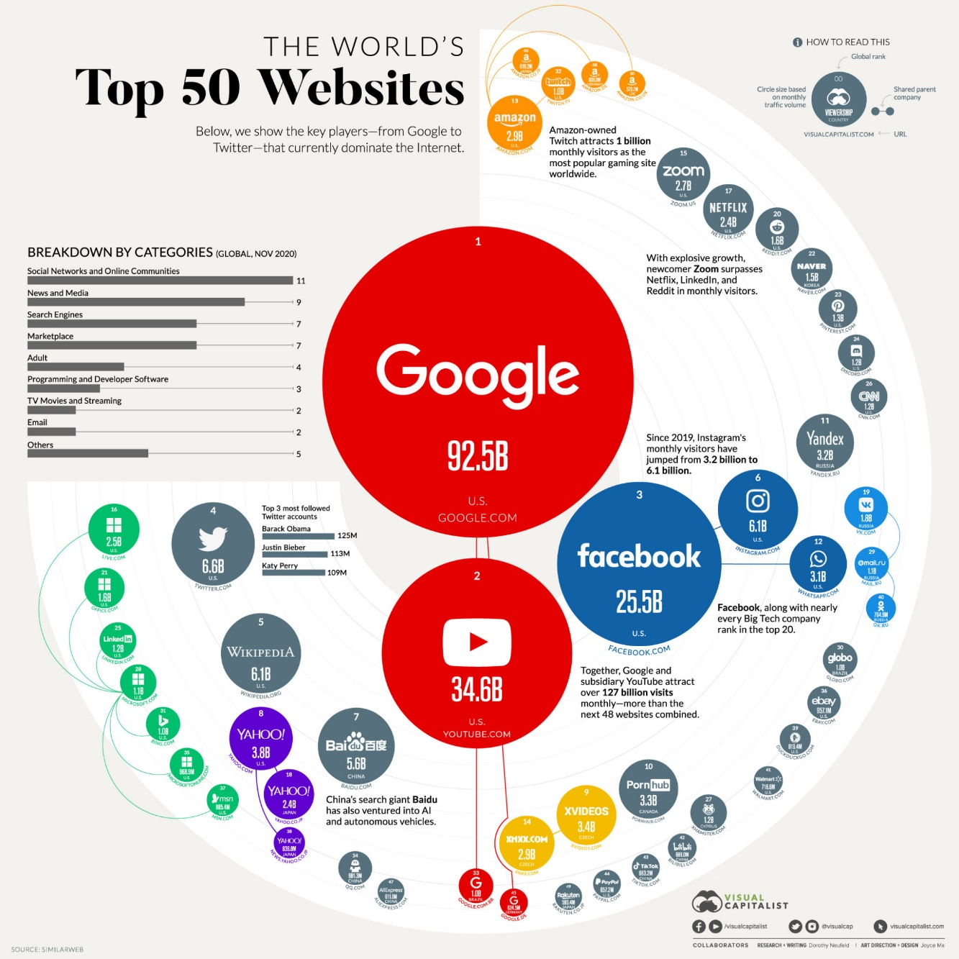
BUSINESS UNDERSTANDING
Why YouTube?
Second most-visited website (monthly)
Google: 92.5 Bn
YouTube: 34.6 Bn
Facebook: 25.5 Bn
YouTube is one of the most popular and premier video-sharing platforms by Google that allows content creators, be it individuals or companies to create a channel and upload videos of all different kinds.
To manage & keep track of such large volumes of videos and creator channels, YouTube records a lot of information/data about how viewers interact with the channel, and its videos by keeping track of metrics such as shares, likes, subscribers, playlists, etc.
Source: https://www.visualcapitalist.com/the-50-most-visited-websites-in-the-world/

Slide 6
GOALS AND SUCCESS MEASURES
DATA INGENSTION: Ingest data, one-offs and inclemently
ETL DESIGN: Extract, transform and load data efficiently
DATA LAKE: Design and build a new data lake architecture
SCALABILITY: The data architecture should scale efficiently
AWS CLOUD: AWS as cloud provider for storage and data pipeline
REPORTING: Build a Business Intelligence tier, incl. Dashboard

Slide 7
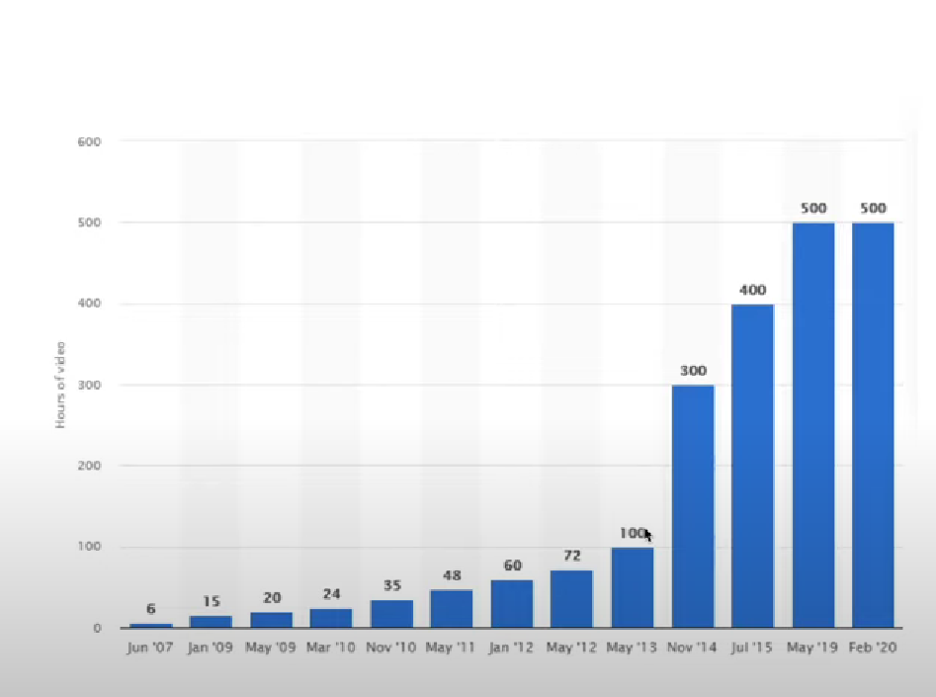
OUR LEARNING
What is Big data?
A term used for massive data sets, with varied and complex structure
With the difficulties of storing and analyzing data
Visualizing for further processes or results

Slide 8


OUR LEARNING
What is Cloud?
"The cloud" refers to servers that are accessed over the Internet, and the software and databases that run on those servers.
By using cloud computing, users and companies do not have to manage physical servers themselves or run software applications on their own machines.

Slide 9
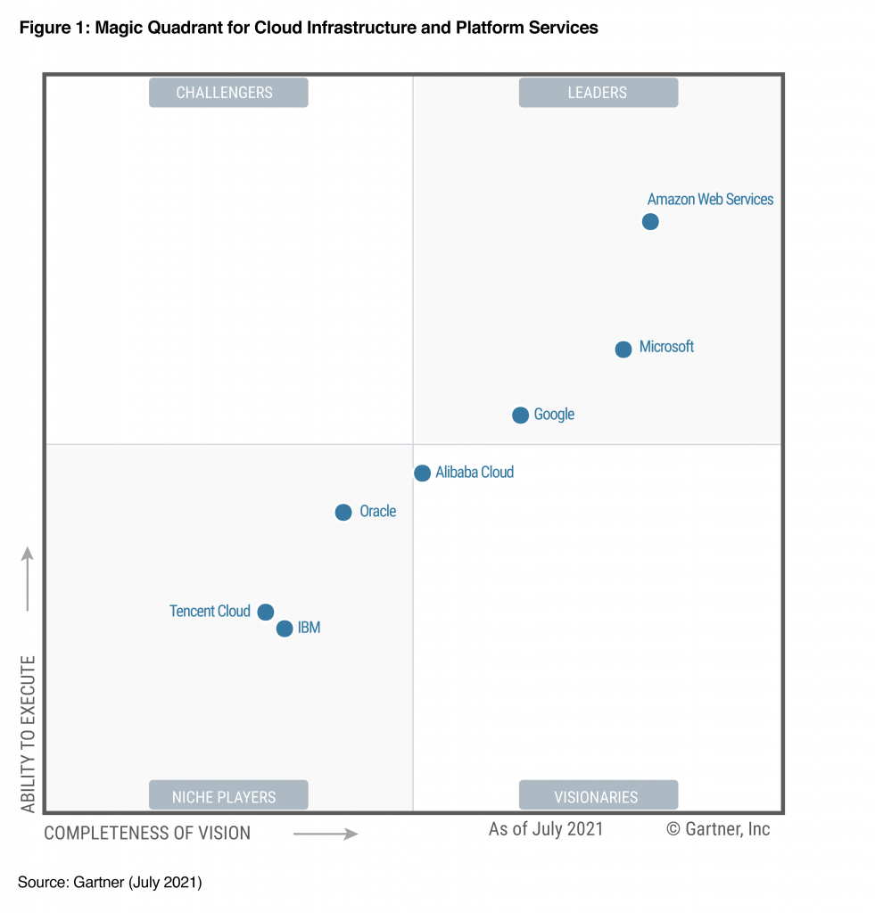
OUR LEARNING
What is AWS?
Amazon Web Services (AWS) is the world’s most comprehensive and broadly adopted cloud platform, offering over 200 fully featured services from data centers globally.
Widely used services:
Computation
Storage & Databases
Networking
Data Lakes & Analytics
AI & Machine Learning
Internet of Things

Slide 10
OUR LEARNING
We are going to work on multiple resources used for Data Engineering such as AWS, Data Lakes, SQL etc. and will learn how to integrate these into a project
To build a data lake from scratch in Amazon S3
Joining Semi structured and structured data
Lake House architecture design
Cost and performance best practices
Data Lake vs Data Warehouse
Data Lake design in Layers and efficiently partition tables for cost performance
WORM (Write Once Read Many) Model
AWS Data Catalogue using AWS Glue
Writing ETL jobs using Apache Spark
Amazon SNS for alerting
SQL using AWS Athena and Spark SQL
Impact of querying the optimized layers
Ingest data incrementally and schema evolution
BI dashboards in Amazon Quicksight

Slide 11
DATA UNDERSTANDING
YouTube (the world-famous video sharing website) maintains a list of the top trending videos on the platform
What is “Trending”?
YouTube uses a combination of factors including measuring users interactions (number of views, shares, comments and likes)
Note that they might not be the most-viewed videos overall for the calendar year
This dataset includes several months (and counting) of data on daily trending YouTube videos. Data is included for the US, GB, DE, CA, and FR regions (USA, Great Britain, Germany, Canada, and France, respectively), with up to 200 listed trending videos per day
Each region’s data is in a separate file.
Data includes the video title, channel title, publish time, tags, views, likes and dislikes, description, and comment count
We will be working with only US data for this project
This dataset was collected using the YouTube API
Link: https://www.kaggle.com/datasets/datasnaek/youtube-new?select=USvideos.csv

Slide 12
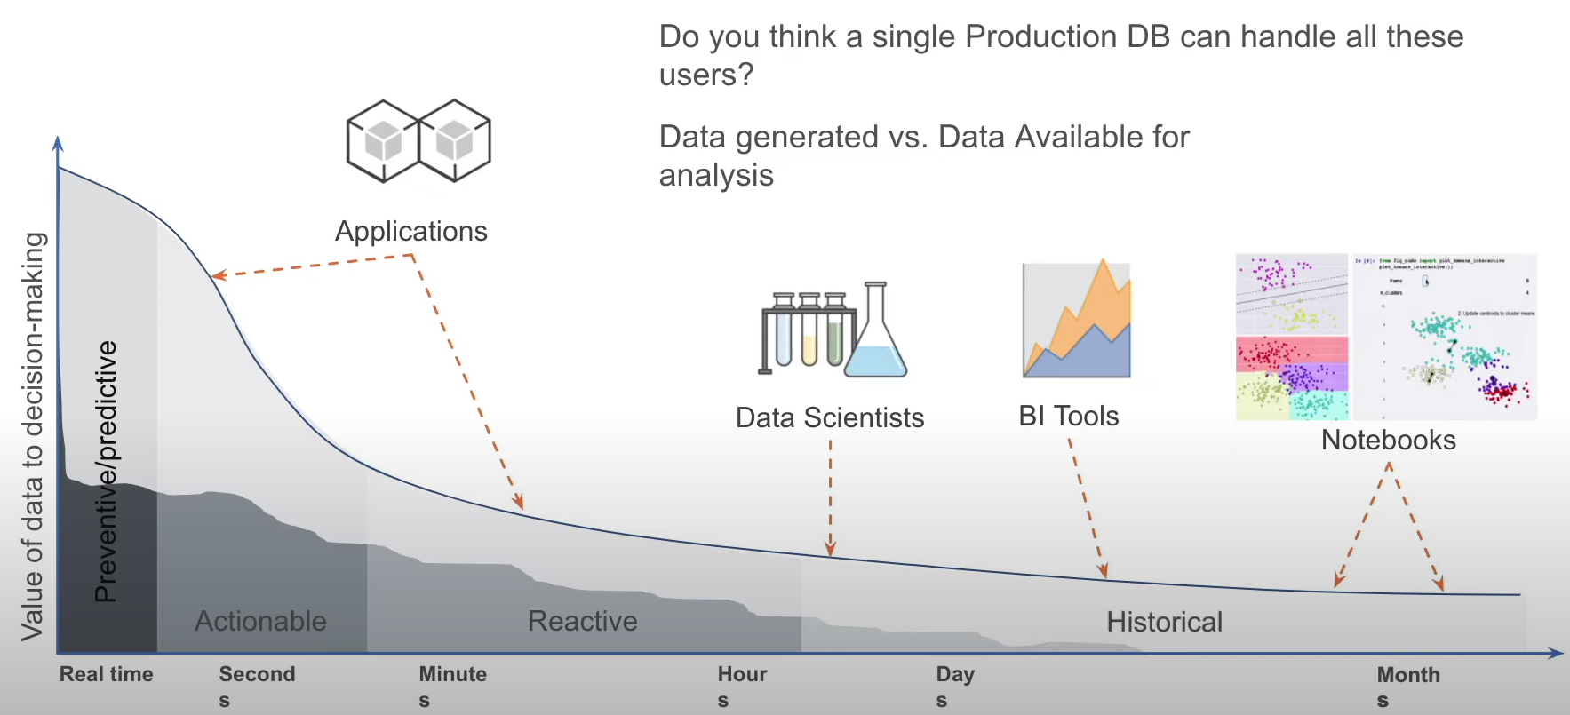
CHALLENGES WORKING WITH BIG DATA

Slide 13
NEXT STEPS
To create an architecture describing the flow of the project
Research and develop the concepts of Data Engineering, AWS and cloud in to project
Analyze the YouTube data to generate some interesting insights
Build seamless data pipelines
Build dashboard with the analysis
And Last, automate the whole process using batch processing

Slide 14
Thank You!

